Slide 1
Cis 2403-object oriented programming
Chapter 4
Understanding Aggregation between classes/objects with the use of UML.
CHAPTER 4 | CLO2: Implement different types of relationships (Association, Aggregation, Composition) between classes to develop object-oriented solutions.

Slide 2
Document Revision CONTROL (DRC)
Version​ | Author​ | Effective Date​ | Change Description​ | DRC No​
1.0​ | Dr Madeleine Togher​ | June 2021 | Define the first version​ | 001​
1.1​ | Dr. Nourchene Benayed | June 2021 | Adding examples | 001
1.2 | Dr Madeleine Togher | July 2021 | Updating code in the new example | 001
X: Major change
Y: MiNOR CHANGE

Slide 3
Lecture Notes
Contents of lectures are based on the textbook, recommended text, and supplementary material
Please read Chapter ??? from page
??? to ???
??? to ???

Slide 4
Lecture OUTLINE
INTRODUCTION
WHEN TO USE AGGREGATION?
1:1 AGGREGATION
KEY TERMS
1:M AGGREGATION
WHAT IS AGGREGATION?

Slide 5
LECTURE OBJECTIVES
At the end of lecture, the student should be able to:
Understand the concept of Aggregation between classes
Implement Unidirectional Aggregation in Java

Slide 6
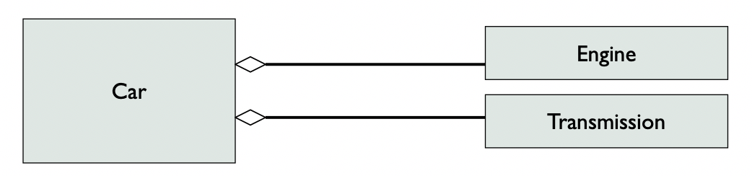
Introduction
Relationship Types
Dependency
Generalization/Specialization
Association
Aggregation
Composition
An aggregation is a special form of association describing:
A logical whole-part relationship between a whole and a constituent part
Where the part can exist independently from the whole
Aggregations are denoted by a hollow-diamond adornment on the association
whole
Parts
Notes:
We have already developed classes (objects) which were related to each other using Association.
For example Association was found between the Person class and Address classes in unidirectional or bidirectional ways using 1:1, 1:M and M:M relationships.
Now we will try to bring more meaning to those associations by using the concept of AGGREGATION
In Aggregation, both the objects can survive alone without each other
This means ending one object instance will NOT affect or destruct the other related object instances

Slide 7
When TO USE AGGREGATION?
Association to Aggregation
If the association name is “consists of”, “is composed of”, “contains” or any synonym, transform the association into aggregation

Slide 8
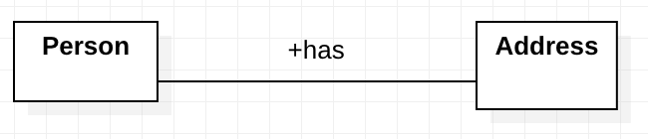
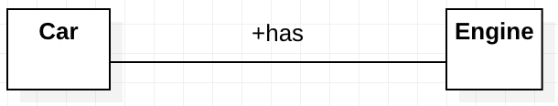
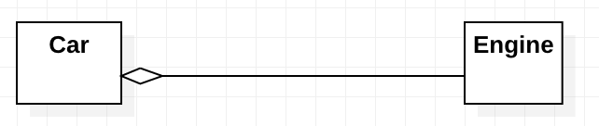
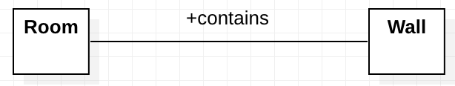
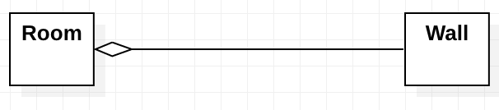
When to USE Aggregation?-Example
With reference to the below class diagrams, could you transform the associations into aggregations?
UML Class Diagram | Yes/No
 | No, it is not aggregation. The association between Person and Address doesn’t describe a whole-part relationship. We cannot say that a Person contains an address
 | Yes, it shall be an aggregation. The association between Car and Engine describes a whole-part relationship. We can say that a Car contains an Engine
 | Yes, it shall be an aggregation. The association between Room and Wall describes a whole-part relationship. We can say that a Room contains Walls
Notes:
Note: there is no need to specify the association name when we transform the association into aggregation

Slide 9
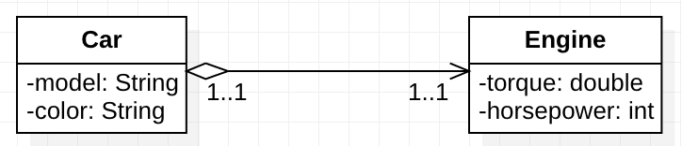
3. 1:1 aggregation - Unidirectional
A Car object relates in a one to one relationship with an Engine object.
A Car has one Engine only
Note: If an object instance of class Car is deleted, the instance of class Engine will still exist and vice versa

Slide 10
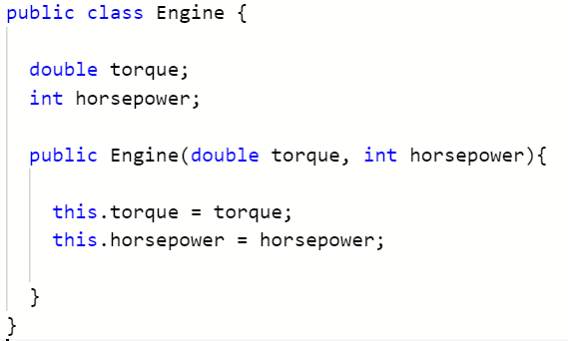
3. 1:1 Aggregation – Unidirectional - coding
Create the Engine class first as it holds no reference and is the most simple of the two classes in the diagram
Engine.java

Slide 11
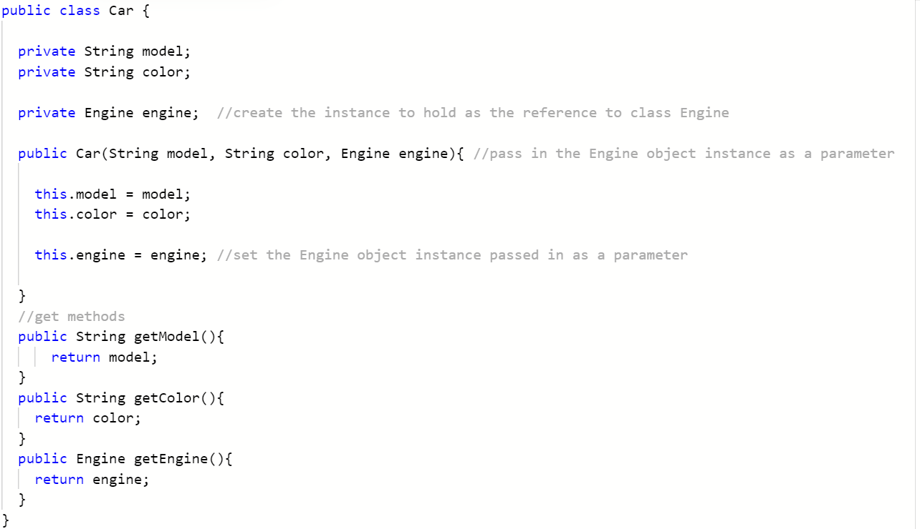
3. 1:1 Association – Unidirectional - coding
Implement the Car class next as it holds a 1:1 reference to the Engine class which is already implemented.
The Engine object instance is created outside (Main.java) and is passed as a parameter to the Car constructor creating the aggregation modelled in the diagram.
Car.java
Notes:
// the Engine object is created outside and is passed as argument to Car constructor
// When this Car object is destroyed, the Engine is still available to objects other than Car
// If the instance of car is garbage collected the associated instance of Engine may not be garbage collected (if it is still referenced by other objects)

Slide 12
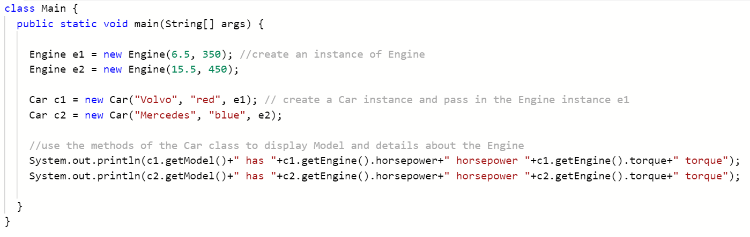

3. 1:1 Association – Unidirectional - coding
Now test the classes associated using 1:1 aggregation by implementing the Main driver class below:
Main.java
Output

Slide 13
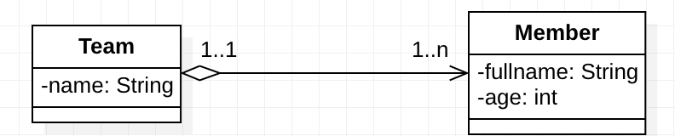
4. 1:N Aggregation - Unidirectional
A Team object relates in a one to many relationship with an Member object.
A Team is composed of one or more Members
Note: If an object instance of class Team is deleted, the instance of class Member will still exist and vice versa
Notes:
We will use an Array for demonstration of the Aggregation concept between classes however this will be covered much later in the course using an ArrayList.

Slide 14
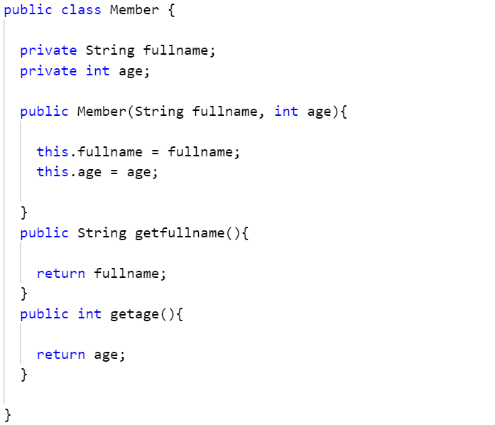
4. 1:M aggregation – Unidirectional - coding
Create the Member class first as it holds no reference and is the most simple of the two classes in the diagram
Member.java
Notes:
The java code of M:N unidirectional Aggregation is same like 1:N unidirectional Aggregation

Slide 15
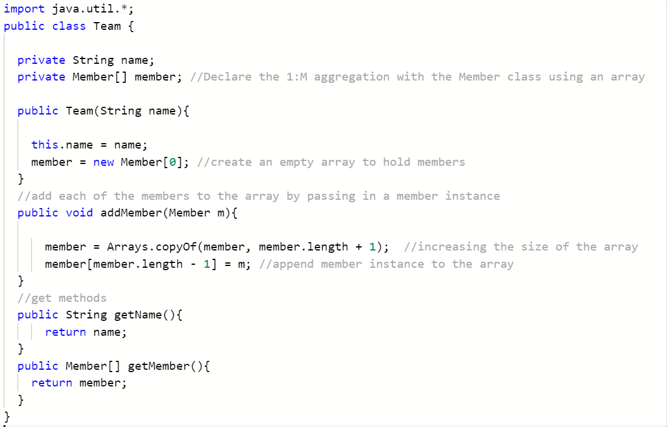
Create the Team class which will establish a unidirectional 1:N aggregation with the Member class using an Array to hold multiple members for each team.
Team.java
Notes:
The java code of M:N unidirectional Aggregation is same like 1:N unidirectional Aggregation

Slide 16
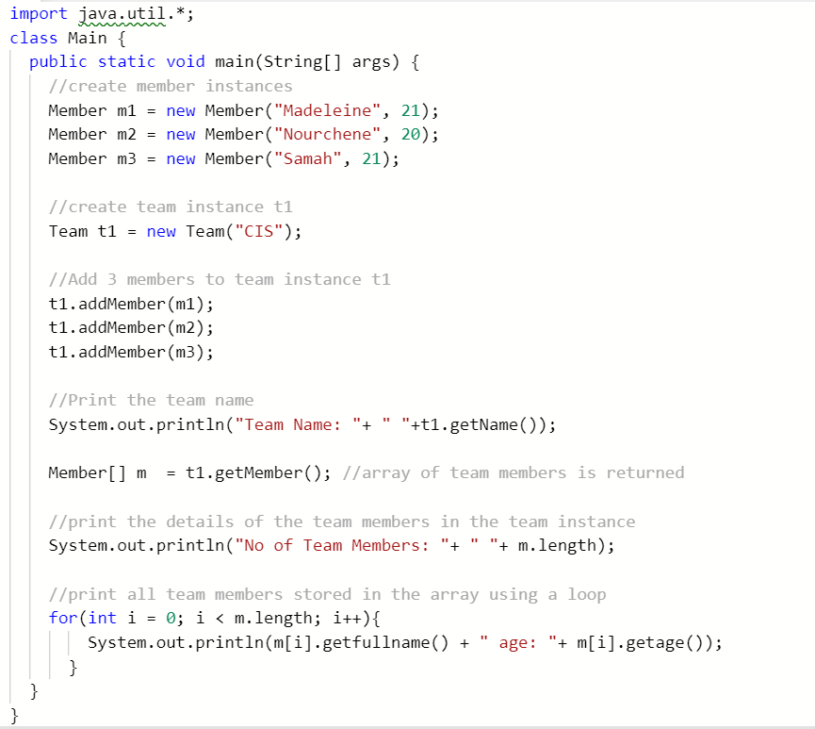
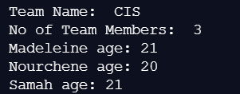
Create a Main driver class to demonstrate the use of 1:N aggregation
Main.java
Output

Slide 17
KEY TERMS
AGGREGATION
UNIDIRECTIONAL
MULTIPLICITY
ARRAYLIST

Slide 18


